Slide 1
Empowering WPF Developers A Journey Through .NET 9 and the Road Ahead
Pankaj Chaurasia
Notes:
Hello Everyone,
Welcome to the session on Empowering WPF developers – A journey through .net 9 and road ahead
I'm Pankaj Chaurasia and I'm the engineering manager for WPF.
I'm thrilled to share the exciting new updates we've bundled for you in WPF

Slide 2
Why WPF?
Brief History
Mission Statement
WPF in .NET 9
Agenda
Fluent Theming
Hyphen Based ligatures
Security
.NET 10 & beyond
Resources
Notes:
We have a packed agenda today, Let's get started
Here's an overview of what we're going to be cover -
Start from an overview of WPF & touching upon aspects of WPF that still make it a preferred choice among desktop UI frameworks
Then a brief bit of history
Mission statement & guiding principles that we are moving forward with
WPF in .NET 9 where we cover Fluent theming, Hyphen based ligature and security updates
Then we take a glimpse at what we plan for .NET 10 & beyond
Last, we leave you with handy resources that you can refer to after the session

Slide 3
Why WPF?
Feature rich
Robust technology
Reliability
.NET Ecosystem
Enterprise applications
Documentation
Notes:
Before the why, let me tell you what WPF is?
WPF is a resolution independent and vector based UI framework used to create Windows desktop applications.
Aimed at bridging the gaps of the predecessor UI frameworks, WPF was created from ground up and had multitude of features that let developers create robust and visually appealing applications.
Introduction of XAML (extensible markup language) revolutionized the way UI frameworks were written. Decoupling of UI logic with the backend logic gave rise to MVVM pattern made it a very popular choice to write desktop applications.
All that being said, why should you pick WPF?
WPF is a feature rich technology (XAML, controls, 2D/3D graphics, animations, styles, documents - all bundled into a single framework). Databinding and other abstractions in WPF help developers to focus on business logic instead of low-level rendering mechanisms.
With WPF, you can leverage huge ecosystem of .NET libraries.
WPF has been around for roughly about 15+ years, which gives it a very good advantage of being time tested, battle-hardened technology. There are several large scale enterprise and commercial applications that use WPF as their UI framework (along with many more that are being added). And of course, the documentation. Online resources such as MSDN, stackoverflow have tonnes of resources to help you unblock should you run into an issue while creating WPF applications.
As mentioned earlier, WPF has been in the market for more than 15+ years., let’s look at WPF history..
--------------------
Includes XAML, controls, data binding, layout, 2D and 3D graphics, animation, styles, templates, documents, media, text, and typography
Unlike earlier technologies that primarily used bitmap graphics, WPF was built on a vector graphics foundation. This allowed for resolution-independent and scalable UIs.
WPF uses the XAML (eXtensible Application Markup Language) to define the user interface, separating it from the underlying logic written in languages like C# or VB.NET.
WPF utilizes DirectX for rendering, enabling hardware acceleration and vector-based graphics.
WPF was designed from the ground up to seamlessly integrate various media types (2D, 3D, video, audio) within the same application framework
Integration with .NET. Huge ecosystem of libraries available (free and paid)

Slide 4
Brief History
.NET 8
Published roadmap after consulting MVPs
OpenFolderDialog Public API change
Hardware acceleration over RDP
.NET 3.5
Changes and improvements in App model, data binding, controls, documents, annotations, 3-D UI elements
.NET 4
New controls: Calendar, DataGrid, and DatePicker.
Multi-Touch and Manipulation
.NET 4.6
Transparent child window support
HDPI and Touch improvements
2007
2010
2015
2023
2006
2008
2012
2018
.NET 3.0
WPF development can be done with VS 2005
.NET 3.5 SP1
Native splash screen support, New WebBrowser control, DirectX pixel shader support.
.NET 4.5
New Ribbon control
.NET Core 3.1
Moved to .NET Core
Notes:
This slide shows how WPF has evolved over the years
WPF started its journey in 2006 with release of .NET fx 3.0 and over the years, with every new release of .NET Fx more and more features were added.
Right around 2018 was the time, that WPF made its way to dotnet core and being open sourced.
From 2018 to 2022 or rather I should say, 2015 to 2022, no new features were added in WPF which raised the question on the future of WPF.
In 2023 with the release of .NET 8 we moved WPF from its former state and introduced the first ever new API addition in WPF (OpenFolderDialog) after being opensource.

Slide 5
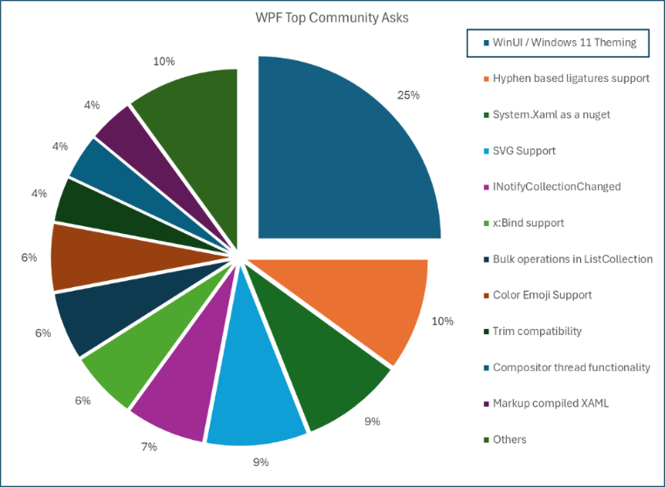
Mission Statement
Enhance WPF for a better user experience in desktop application development
Focus on fundamentals – Performance, Security, Accessibility
Prioritizing features based on community inputs
Building a thriving OSS community
Increased transparency on progress
Notes:
Naturally, this raises the question, where are we going now?
Before we ans that question, i'd like to clarify what is our mission statement - We want to ensure that WPF delivers the best-in-class developer and user experience in Windows desktop application developer space.
To achieve this mission objectives, here are our guiding principles,
- ensuring we have strong roots i.e making sure we are performant, accessible and secure
- we want to deliver features that matter to the community the most
- we don't want to do this in isolation which would defeat the whole purpose of going open-source. Basically, build a thriving Open source community that guide us in shaping the future of WPF
- And last but not least, making sure that we are engaged with our community with regular updates and announcements to increase transparency.
To all this end, we took an inventory of the top voted asks in the community and decided to work our way down from the most requested features.

Slide 6
WPF in .NET 9
Fluent Theming
Hyphen based ligatures
Security updates
Windows 11 styled fluent themes with support for accent colors, light/dark modes, etc.
Support for hyphen based ligatures
Aimed at improving the security of WPF applications
Notes:
With the release of .NET 8, we turned our focus to identifying new features for .NET 9. We conducted a comprehensive survey within the community and engaged in numerous meetings with stakeholders and enterprises. The feedback was clear: theming and ligatures emerged as top priorities.
These features are not just enhancements; they are pivotal in aligning with the community’s needs.
With all that background & context in place, Here's what WPF in .NET 9 is loaded with -
First and foremost - Fluent Theming - WPF now ships with new theme that follow Windows 11 style guidelines (more on that in a bit)
Next, we have hyphen based ligatures
and last we have security updates

Slide 7
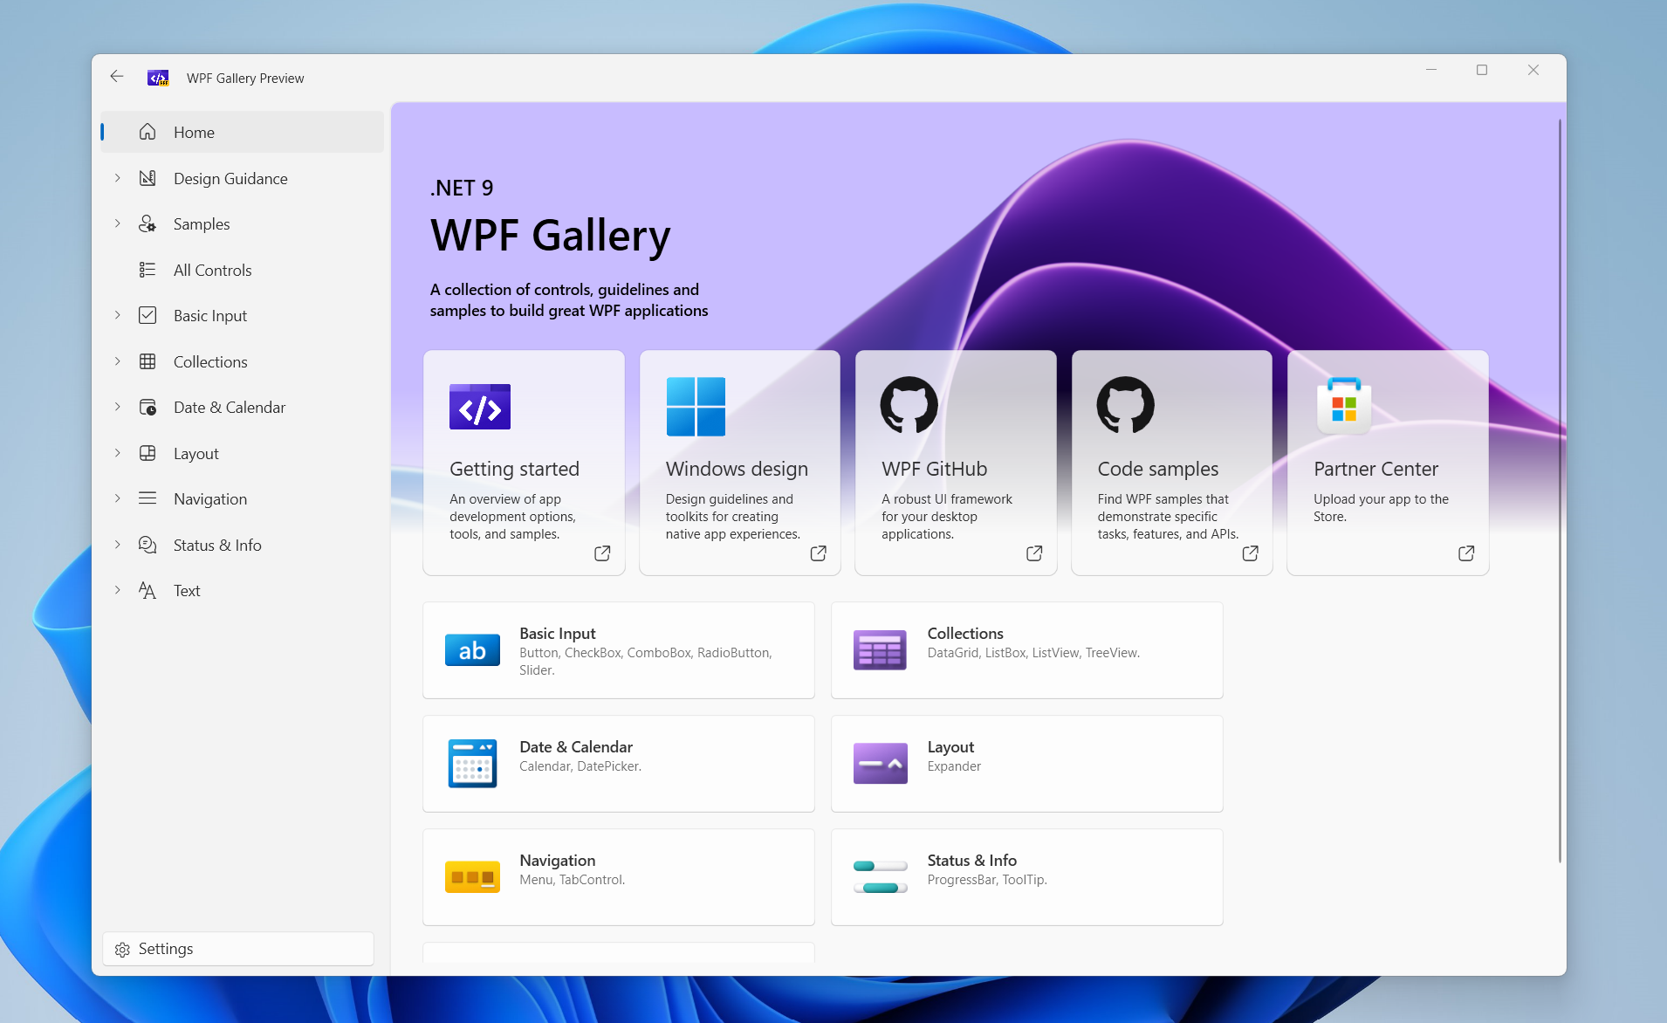
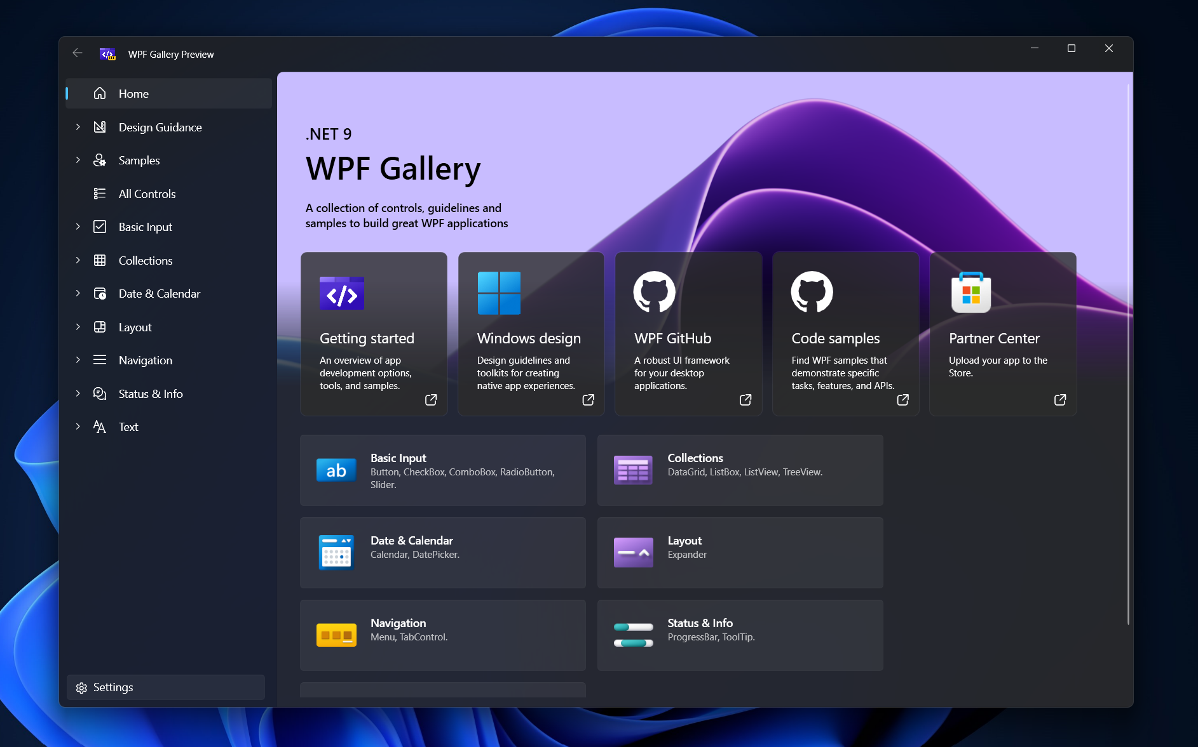
Fluent Theming
Modern Windows 11 styled experience for WPF applications
Fluent design principles
Rounded corners
Accent color support
Light/Dark mode support
Window Backdrop
A11y compliant
Showcase – aka.ms/wpfgallery
Notes:
Lets see Fluent Theming first
Why - As a UI framework, obviously UI appearance is a fundamental aspect. The last theme that was shipped with WPF was Aero2 which was designed along Windows 7 design guidelines. Windows itself has evolved over the years offering revamped UI and user experience. We wanted to ensure WPF applications are not left behind and can take advantage of the new user experience right out of the box.
Overall, the goal of modern theming in WPF is to provide a seamless user experience, ensuring that WPF applications remain visually appealing and aligned with the evolving landscape of Windows UI design.
Besides, providing newer themes were among the top asks from the community.
The new themes comes with support for rounded corners, accent colors, light/dark modes, window backdrop features.
You can take a glimpse of all the controls and the entire fluent theming on WPF gallery.
WPF gallery is a WPF application packaged as a MSIX and deployed to Microsoft store.
You can access this via aka.ms/wpfgallery

Slide 8
Demo: Fluent Theming
Notes:
Next, lets deep dive into Fluent Theming
We start with seeing a sample WPF application with default Aero2 theme. The application we’ll cover today is a sample Photo viewer application.
This application consist of a photo gallery view and then a separate page that allows users to view and edit additional properties of the image.
Here’s what the plan is –
We’ll get to upgrading the theme to Fluent theme
Next, we fix the styles that are not compatible with fluent
We’ll checkout various OS integration features (such as accent color change, light/dark mode, backdrop support)
We’ll also visit use of experimental APIs and switches that help you control aspects of theming
That's all for the fluent demo. Let's switch back to the deck

Slide 9
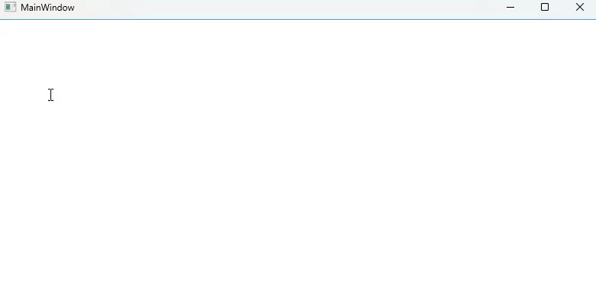
Hyphen based ligatures
Special characters that combine multiple letters into a single glyph
Top voted (as of Nov, 2024) issue on GitHub
Improves application experiences which have code editor like features
Notes:
Next deliverable shipping in .NET 9, is the support for hyphen based ligatures
Ligatures are embeddings in fonts that are comprised of multiple special characters into a single glyph
You may have seen this effect on various modern code editors such as Visual Studio or Visual Studio Code where certain fonts have special rendering for arrows, comments, negation, etc.
If your WPF application had such an editor, prior to .NET 9, for all the ligatures with hyphen in them, wouldn't be displayed correctly on screen.
This issue was among the highest voted item in our GitHub issue list.
I'm glad to inform you, that with .NET 9, we have fixed this problem and your editor applications can have improved user experiences.
Here's the animated view of the effect of hyphen based ligatures in a WPF application.

Slide 10
Security
Ensuring WPF applications remain secure
Multiple security issues were fixed in .NET 9
PenIMC, Documents, Packaging , XPS, etc.
BinaryFormatter removal
Notes:
Next we move to Security
Ensuring that WPF users remain secure continues to be our topmost priority.
With .NET 9 release, we were able to fix security vulnerabilities in multiple areas.
Firstly, we have fixed several vulnerabilities in PenIMC. This component is crucial for handling pen input in WPF applications, and securing it ensures that applications relying on pen input are protected from potential exploits.
Next, we have made important security improvements in the Documents and Packaging components. These components are responsible for handling various document formats and packaging operations within WPF. By addressing security issues in these areas, we ensure that documents processed by WPF applications are safe from tampering and unauthorized access.
We have also focused on securing the XPS (XML Paper Specification) component. XPS is widely used for creating and sharing documents in a fixed-layout format. By fixing security vulnerabilities in XPS, we protect the integrity and confidentiality of documents created and shared using this format.

Slide 11
BinaryFormatter removal
Move away from using BinaryFormatter
.NET has moved away from using BinaryFormatter for security reasons
We recommend use of alternative data serialization mechanisms which are more secure such as XmlSerializer, DataContractSerializer, BinaryReader and BinaryWriter
With .NET9 release, BinaryFormatter is marked as an opt-in dependency.
NOT RECOMMENDED !! - For extreme cases, where BinaryFormatter usage cannot be removed, you can install System.Runtime.Serialization.Formatters and add the following property to the csproj <EnableUnsafeBinaryFormatterSerialization>true<EnableUnsafeBinaryFormatterSerialization>
Notes:
Next, let me dive into BinaryFormatter usage in WPF
One of the most significant changes in .NET 9 is the removal of BinaryFormatter.
BinaryFormatter is used during serialization and deserialization of binary objects.
BinaryFormatter has been a source of security concerns due to its potential for deserialization vulnerabilities. In .NET 9, we have removed BinaryFormatter from WPF, replacing it with more secure alternatives.
.NET as a whole is moving away from BinaryFormatter due to it's inherent insecure design. While it does offer the flexibility, over the years, we have since found out that the design has a serious security flaws which cannot be fixed in place.
This is the reason, we recommend .NET applications to move away from use of BinaryFormatter.
Instead of binaryformatter, we recommend using one of the alternatives available such as XmlSerializer, DataContractSerializer, BinaryReader, BinaryWriter and JSON.
We also realize that removing BinaryFormatter all at once may not be feasible for all .NET applications out there, which is why we have removed the BinaryFormatter from .NET and moved it as an opt-in dependency.
We strongly recommend that you move away from using BinaryFormatter.
However, if you must, then you'll have to include a separate package "System.Runtime.Serialization.Formatters" and enable a build property "EnableUnsafeBinaryFormatterSerialization",
this would unblock you from using BinaryFormatter for .NET 9

Slide 12
.NET 10 & Beyond
Improving fundamentals
Better performance
Developer productivity enhancements
Notes:
Now, with .NET 9 released, here's an overview of what our focus would be for .NET 10 & Beyond -
As mentioned earlier, as UI framework, we ought to have an appealing User experience and make sure that the framework is performant, secure and reliable.
Which is why we will continue to focus on improving fundamentals (including but not limited to better com support, more accessible controls, etc.
Next is performance (performance wins that take advantage of new .NET abstractions that lead to better rendering performance, startup performance, trimming and nativeaot capabilities)
Last but not least, making sure developers remain productive. This includes reducing XAML verbosity, enhanced tooling support for creating rich and performant WPF applications.

Slide 13
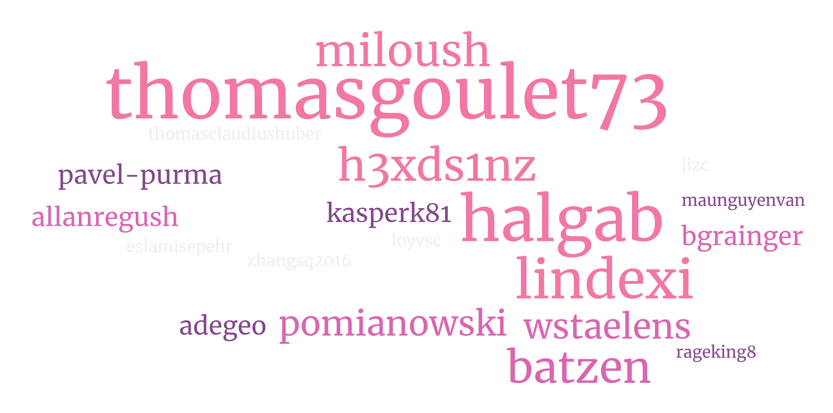
Thanks to our community
And many others, who have helped improve WPF by raising issues, pull requests, participating in discussions and API reviews.
Notes:
To be honest, everything we have been able to achieve could not have been possible without the support of our awesome community members.
Our heartfelt thanks to milosh, Thomas, h3xds1nz (I'm sorry if I didn't get the GitHub name right), lindexi, batzen and everyone who has contributed to issues, PRs, participating in discussions and API reviews and helping improve WPF.
We cannot be more grateful to Lescez Pomain (who is the author of WPFUI) for his help and support in delivering Fluent Theming in WPF.

Slide 14

Get .NET 9
Download .NET 9 aka.ms/get-dotnet-9
Notes:
Up next, we are very excited with this release and cannot wait to hear what new things you'll be building with .NET 9.
Here's a short url to get you started with .NET 9

Slide 15
Resources
https://github.com/dotnet/wpf
https://aka.ms/wpf
WPF GitHub repository
MSDN for WPF
https://aka.ms/wpfgallery
https://aka.ms/fluent
WPF Gallery application with Fluent theming enabled
Fluent Design guidelines
https://aka.ms/binaryformatter
https://aka.ms/wpfsamples
BinaryFormatter vulnerabilities and mitigation
WPF Samples GitHub repository
https://aka.ms/get-dotnet-9
https://aka.ms/wpf/roadmap
Download and install latest .NET 9 release
WPF Roadmap
Notes:
Here are some resources that would be helpful for trying out new things in .NET

Slide 16
Thank you
Notes:
That's a wrap., I want to thank you all for giving me the opportunity to share exciting updates in WPF.
Please do let us know how we can improve and make .NET great!

